Slide 1
Anomaly detection in time series data
Zaytsev Alexey, Lab head, Skoltech
Nikita Kluchnikov, PhD student
31 January 2020

Slide 2
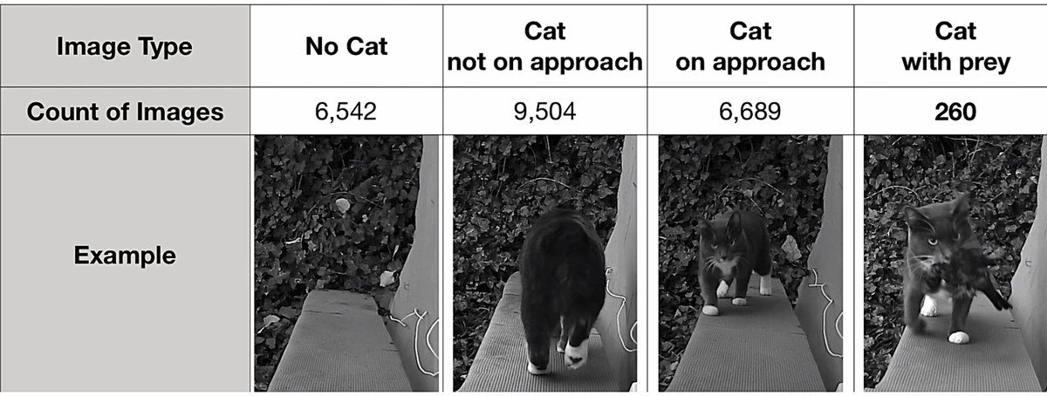

Problem statement
The problem is to find objects that anomalous given training data
Normal data
Anomaly
https://www.theverge.com/tldr/2019/6/30/19102430/amazon-engineer-ai-powered-catflap-prey-ben-hamm

Slide 3
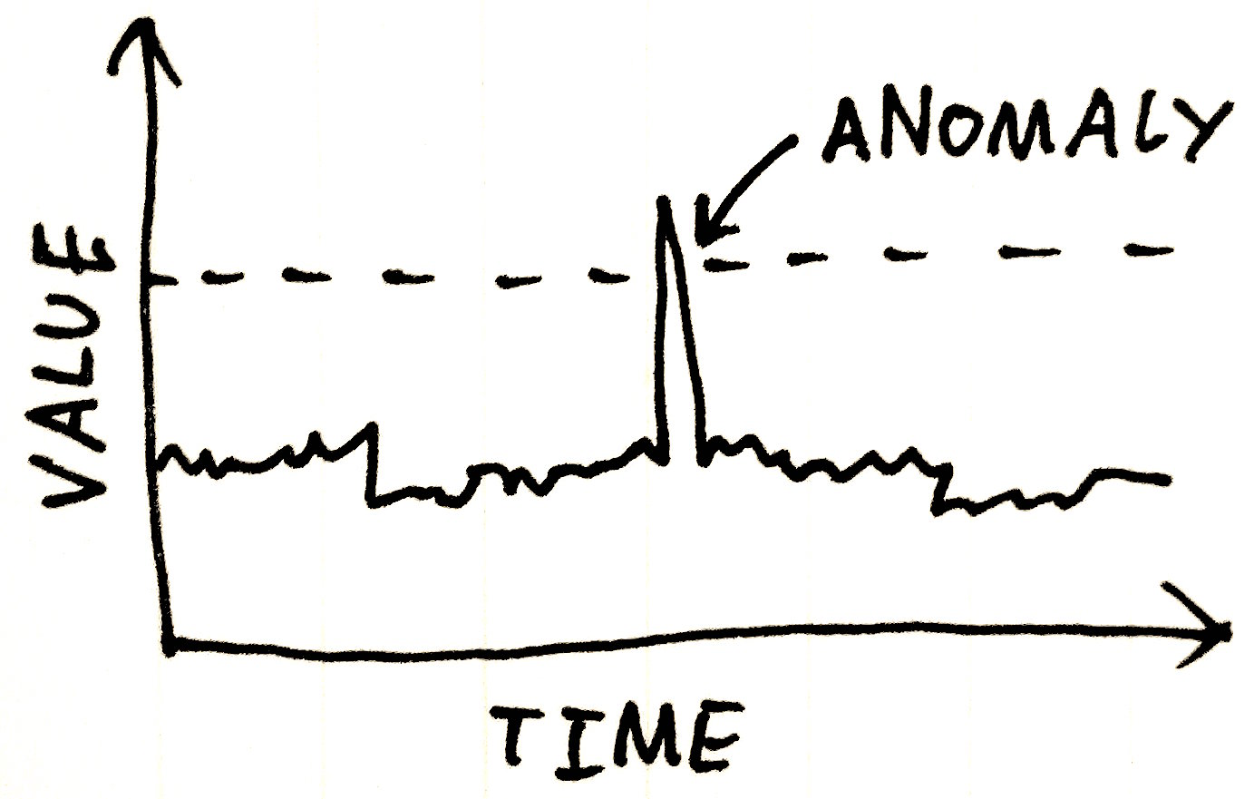
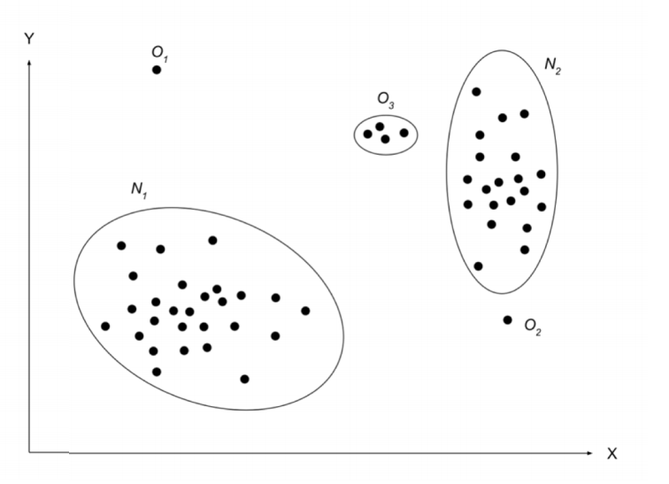
Problem examples
Fraud detection
Failure detection for an airplane
Intrusion detection
Earthquake prediction
Typical challenges:
Requires problem-specific knowledge
New problem – new approach
Hard to identify something we don’t see
Bunch of various problem statements
https://arxiv.org/pdf/1901.03407.pdf

Slide 4
Taxonomy with respect to available data
Sequential data
Non-sequential data
Supervised
Unsupervised
Semi-supervised
https://arxiv.org/pdf/1901.03407.pdf

Slide 5
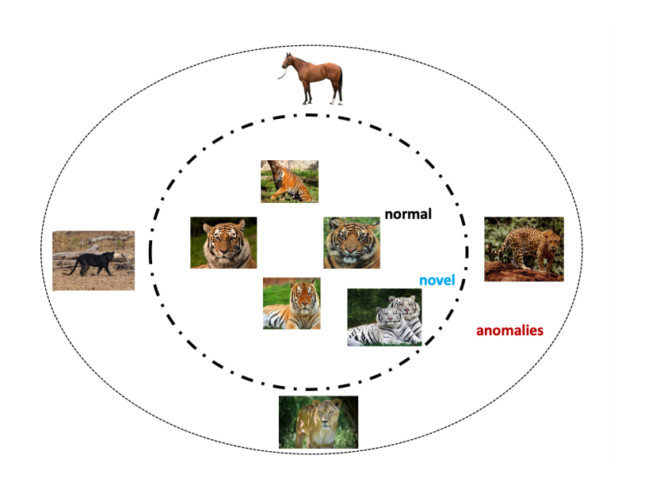
Taxonomy with respect to problem statement
Novelty detection
Anomaly detection
Supervised
Unsupervised
Semi-supervised
https://arxiv.org/pdf/1901.03407.pdf

Slide 6
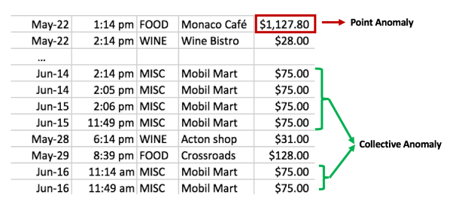
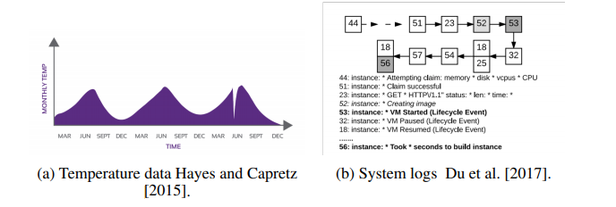
Anomaly type
Point
Collective or group
Contextual or conditional
https://arxiv.org/pdf/1901.03407.pdf

Slide 7
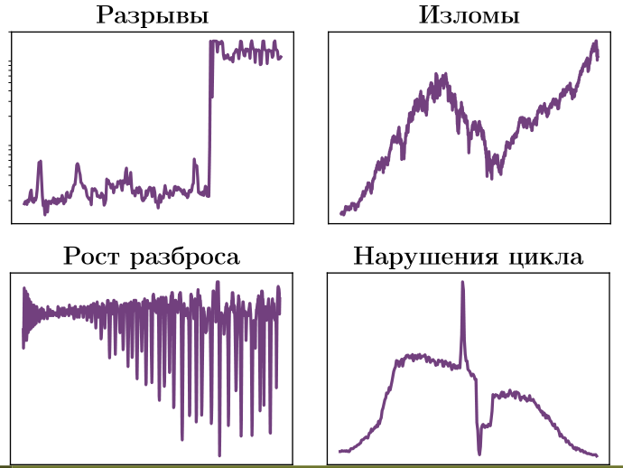
Change point detection
Discontinuity
Kinks
Variance growth
Violation of dynamic
Slide by A. Artemov, E. Burnaev

Slide 8
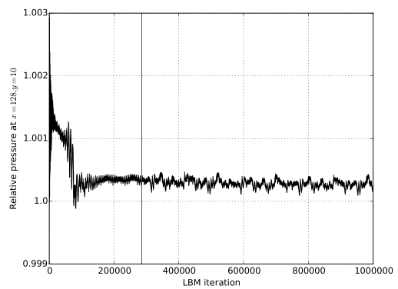
Real world change point: fluid pressure
Fluid pressure in a hydrodynamic system for a numerical model based on Boltzmann method
Slide by A. Artemov, E. Burnaev

Slide 9
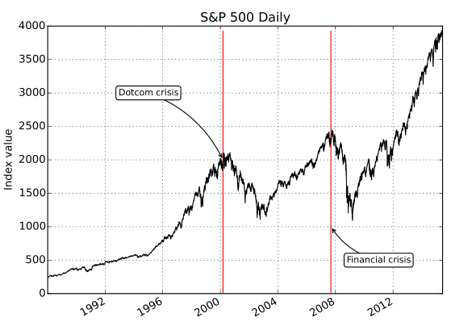
Real world change point: S&P500 index
Dynamic of S&P500 stock exchange index for 7 years
Slide by A. Artemov, E. Burnaev

Slide 10
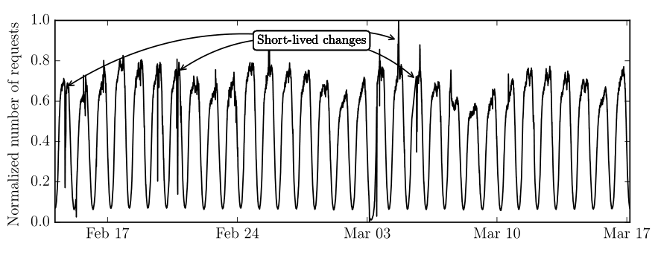
Real world change point: internet data
Web-site visits
Slide by A. Artemov, E. Burnaev

Slide 11
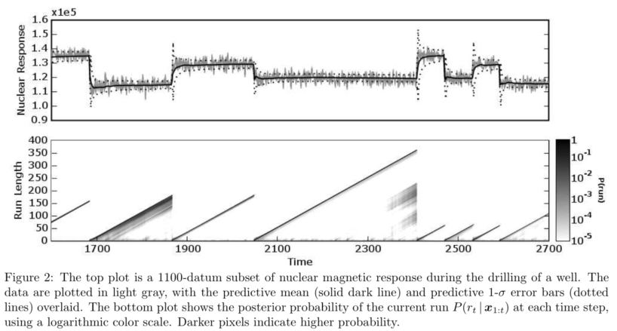
Real world change point: drilling data
Nuclear-magnetic response during the drilling of a well
Slide by A. Artemov, E. Burnaev

Slide 12
Applications of change point & anomaly detection
Detection of computer network intrusions (attacks leading to the change of transmitted traffic volume) [Kim et al. 2004; Alexander G Tartakovsky 2003;Alexander G. Tartakovsky et al. 2006]
Anomaly detection in data transmission networks (video streams in systemsvideo surveillance, network traffic, etc.) [Casas et al. 2010; Lakhina, Crovella andChristiphe Diot 2004; Lakhina, Crovella and Christophe Diot 2004; Pham et al. 2014]
Fault detection and isolation of components for vehicle management system [Malladi et al. 1999; Willsky 1976]I Monitoring the integrity of a geopositioning system [Basseville et al. 2002]
Detection of changes in rock structure during well drilling [Adams et al.2007]
Finding the beginning of a recession or economic growth [Andersson et al. 2002]
Slide by A. Artemov, E. Burnaev

Slide 13
Applications of change point & anomaly detection
Detection of changes in the volatility of the Dow Jones index [Adams et al. 2007]
Signal detection for observing of underwater targets [Streit et al. 1999]
Automatic detection of abnormal human behavior for CCTV [Pham et al. 2014]
Automatic quality control of products [Ben-Gal et al. 2003;Girshick, Meyer A and Rubin 1952; Shewhart 1931]
Monitoring and analysis of mortality and morbidity of lung cancer [Dass 2009;Dass et al. 2011; Taweab et al. 2015]
Outbreak Detection [MacNeill et al. 1995]
Detection of cardiac arrhythmias (sudden changes in heart rate) [Willsky1976]
Prediction of transient ischemic attacks (transient disturbancescerebral circulation) [Cerutti S. et al. 1993]
Diagnosis of intrauterine growth retardation [Petzold et al. 2004]
Slide by A. Artemov, E. Burnaev

Slide 14
Can you identify anomalies?
Let’s try!
https://speakerdeck.com/skibish/a-note-about-anomalies-article

Slide 15
Operational definitions of anomalies
Distance-based or density-based definitions:
D-Distance Anomalies are instances which have fewer than p neighboring points within a distance D.
kth NN Distance Anomalies are the top-ranked instances whose distance to the kth nearest neighbor is greatest.
Average kNN Distance Anomalies are the top-ranked instances whose average distance to the k nearest neighbors is greatest.
Density-based Anomalies are instances which are in regions of low density or low local/relative density.
https://federation.edu.au/__data/assets/pdf_file/0011/443666/ICDM2018-Tutorial-Final.pdf

Slide 16
Other operational definitions of anomalies
2. Isolation-based anomalies are instances which are most susceptible to isolation.
3. ZERO++: anomalies are instances which have the highest number of subspaces having zero appearances (over a set of subsamples).
Definition of outlier by Hawkins (1980):
“An outlier is an observation which deviates so much from the other observations as to arouse suspicions that it was generated by a different mechanism”
Hawkins, D. (1980) Identification of outliers. Monographs on Applied Probability and Statistics.
https://federation.edu.au/__data/assets/pdf_file/0011/443666/ICDM2018-Tutorial-Final.pdf

Slide 17
Comparative studies of methods for anomaly detection
https://federation.edu.au/__data/assets/pdf_file/0011/443666/ICDM2018-Tutorial-Final.pdf

Slide 18
Comparison of anomaly detection algorithm is not an easy thing
• Methods using different operational definitions
• Rely on ground truth provided in the given dataset, and the ground truth is only used for the evaluation of how well a method performs.
• Reality: few or no ground truth
https://federation.edu.au/__data/assets/pdf_file/0011/443666/ICDM2018-Tutorial-Final.pdf

Slide 19
Factor influencing comparison
• The nature of the anomaly detection problem
• The data properties of benchmark datasets: datasets chosen
• The characteristics of algorithms: number of parameters, sensitivity to parameter setting, ensemble or not; how it performs under different conditions
• Evaluation methodology: best performance, test accuracy
• A good measure in assessing the “goodness” of the ranking outcome
No free lunch?
https://federation.edu.au/__data/assets/pdf_file/0011/443666/ICDM2018-Tutorial-Final.pdf

Slide 20
Study from Emmott et al (2016)
Evaluation conducted based on real-world datasets, modified across four dimensions:
Point difficulty, relative frequency of anomalies, clusteredness of anomalies & relevant of features
8 Methods compared in the study
• Robust kernel density estimation
• Ensemble Gaussian Mixture Model
• One-class SVM & Support vector data description
• LOF & kNN Angle-based Outlier Detection
• Isolation Forest (iForest)
• Lightweight Online Detector of Anomalies (LODA)
Measures: AUC and Average Precision
Data properties: Data size: >1k ; #dim < 200;
Emmott, A. F., Das, S., Dietterich, T. G., Fern, A., Wong, W.-K. (2016). A Meta-Analysis of the Anomaly Detection Problem. arXiv:1503.01158
https://federation.edu.au/__data/assets/pdf_file/0011/443666/ICDM2018-Tutorial-Final.pdf

Slide 21
Assessment design
Scale of the study:
• 19 mother datasets
• 25,685 benchmark datasets
• 205,480 micro-experiments (8 methods under comparison)
From a mother dataset, different datasets with the following four dimensions (a few levels for each dimension) are generated:
• Point difficulty (distance from boundary between normal points and anomalies)
• Relative frequency (.001, .005, .01, .05, .1 anomalies)
• Clusteredness (scattered versus clustered anomalies)
• Feature irrelevance (add irrelevant attributes of different distance ratios: 3 levels)
Emmott, A. F., Das, S., Dietterich, T. G., Fern, A., Wong, W.-K. (2016). A Meta-Analysis of the Anomaly Detection Problem. arXiv:1503.01158
https://federation.edu.au/__data/assets/pdf_file/0011/443666/ICDM2018-Tutorial-Final.pdf

Slide 22
Recommendations from Emmott et al (2016)
Isolation Forest [1] (in general and in large feature space of unknown quality)
ABOD [2] and LOF [3] for highly clustered anomalies
Isolation Forest [1] and LODA [4] scale well to large data sets while the other algorithms do not.
“.. over-positive results reported in literature are not particularly helpful measuring progress.”
[1] Liu, F. T., Ting, K. M., Zhou, Z .H. (2008) Isolation Forest. In Proceedings of IEEE ICDM, 413-422.
[2] Kriegel, H-P., Schubert, M., Zimek, A. (2008) Angle-based outlier detection in high-dimensional data. In Proceedings of KDD, 444-452.
[3] Breunig, M. M., Kriegel, H.-P., Ng, R. T., Sander, J. (2000) LOF: Identifying density-based local outliers. In: Proceedings of the ACM SIGMOD International Conference on Management of Data, 93-104
[4] Pevny, T. (2016) Loda: Lightweight On-line Detector of Anomalies. Machine Learning, 102(2), 275–304.
Emmott, A. F., Das, S., Dietterich, T. G., Fern, A., Wong, W.-K. (2016). A Meta-Analysis of the Anomaly Detection Problem. arXiv:1503.01158
https://federation.edu.au/__data/assets/pdf_file/0011/443666/ICDM2018-Tutorial-Final.pdf

Slide 23
Recommendation from Aggarwal & Sathe (2017)
TRINITY [5] (a meta-ensemble of the following three base methods)
iForest
kNN
Kernel Mahalanobis – a soft version of kernel PCA [6]
Conclusions from Aggarwal & Sathe (2017):
iForest do extremely well
Distance-based detectors are robust
No detector was able to consistently perform better than all other detectors.
[5] Aggarwal, C. C., Sathe, S. (2017) Outlier Ensembles: An Introduction. (Chapter 6)
[6] Hoffmann, H. (2007). Kernel PCA for Novelty Detection, Pattern Recognition, 40(3), 863–874.
Aggarwal, C. C., Sathe, S. (2017) Outlier Ensembles: An Introduction. Springer International Publishing. (Chapter 6)
https://federation.edu.au/__data/assets/pdf_file/0011/443666/ICDM2018-Tutorial-Final.pdf

Slide 24
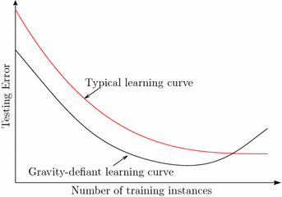
Recommendation from Ting et al (2017)
It shows that NN anomaly detectors have gravity-defiant behaviour, contrary to the conventional wisdom.
Focus on theoretical analyses of the behaviour of NN anomaly detectors only: iNNE, aNNE and kNN
The experiments are designed to verify the analytical result: NN anomaly detectors have gravity-defiant behaviour
Methodology: 20 trials of train-and-test; measure: AUC;
8 datasets with data size: 5k – 300k; #dim: 3 – 5408; %anomalies: .03-2.3
Variations in data properties: %anomalies, geometry, number of clusters
Ting, K. M., Washio, T., Wells, J. R., Aryal, S. (2017). Defying the Gravity of Learning Curve: A Characteristic of Nearest Neighbour Anomaly Detectors. Machine Learning. Vol 106, Issue 1, 55-91.
https://federation.edu.au/__data/assets/pdf_file/0011/443666/ICDM2018-Tutorial-Final.pdf

Slide 25
Recommendation from Ting et al (2017)
Recommend aNNE (an ensemble of 1NN) over kNN
Easier to tune 𝜓 (aNNE) than 𝑘 (kNN), as the latter is sensitive data size.
aNNE has significantly smaller optimal sample size than kNN.
Run significantly faster in large datasets
Recommend iNNE over aNNE because the former reaches its optimal detection accuracy with a significantly smaller sample size.
Note that the same gravity-defiant behaviour is observed in iForest too.
Ting, K. M., Washio, T., Wells, J. R., Aryal, S. (2017). Defying the Gravity of Learning Curve: A Characteristic of Nearest Neighbour Anomaly Detectors. Machine Learning. Vol 106, Issue 1, 55-91.
https://federation.edu.au/__data/assets/pdf_file/0011/443666/ICDM2018-Tutorial-Final.pdf

Slide 26
Top recommendations from the three studies
Isolation based methods: iForest and iNNE [8]
All known weaknesses of iForest are overcome by iNNE, with higher time cost; but still has significantly lower time cost than kNN.
Nearest neighbour-based methods: aNNE and kNN
Clustered anomalies: ABOD & LOF
iNNE [5] can do well in detecting clustered anomalies.
Kernel Mahalanobis [6]: The key weakness is the time cost
Among the compared methods, iForest and iNNE have the highest detection accuracy and also have the lowest time cost.
Simple methods should be used as the baseline to justify any more complicated methods.
[6] Hoffmann, H. (2007). Kernel PCA for Novelty Detection, Pattern Recognition, 40(3), 863–874.
[8] Bandaragoda, T. R., Ting, K. M., Albrecht, D., Liu F. T., Wells, J. R. (2018). Isolation-based Anomaly Detection using Nearest Neighbour Ensembles. Computational Intelligence. Doi:10.1111/coin.12156.
https://federation.edu.au/__data/assets/pdf_file/0011/443666/ICDM2018-Tutorial-Final.pdf

Slide 27
Characteristics of Ideal Anomaly Detectors
Few parameters
• parameter-free the best
• Easy to tune; not too sensitive to parameter setting
Fast runtime: can scale up to large datasets and high dimensional datasets
Low space complexity
Known behaviours under different data properties
Can deal with different types of anomalies:
• Clustered anomalies vs scattered anomalies
• Local anomalies vs global anomalies
https://federation.edu.au/__data/assets/pdf_file/0011/443666/ICDM2018-Tutorial-Final.pdf

Slide 28
Details on methods for anomaly detection:
Isolation forest iForest
Isolation Nearest Neighbours Ensembles INNE
https://federation.edu.au/__data/assets/pdf_file/0011/443666/ICDM2018-Tutorial-Final.pdf

Slide 29
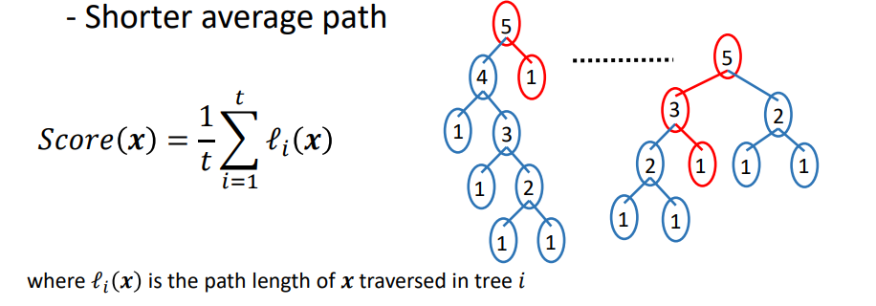
Isolation forest
A collection of isolation trees (iTrees)
Each iTree isolates every instance from the rest of the instances in a given sample
Anomalies are ‘few and different’
- More susceptible to isolation
- Shorter average path
https://federation.edu.au/__data/assets/pdf_file/0011/443666/ICDM2018-Tutorial-Final.pdf
[Liu et al ICDM 2008]

Slide 30
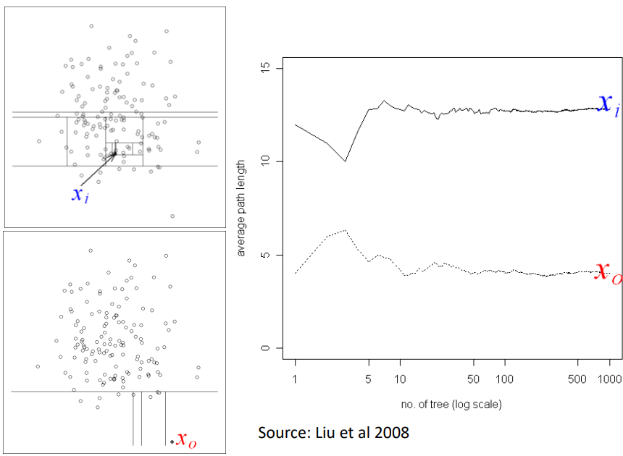
Isolation example
https://federation.edu.au/__data/assets/pdf_file/0011/443666/ICDM2018-Tutorial-Final.pdf
[Liu et al ICDM 2008]

Slide 31
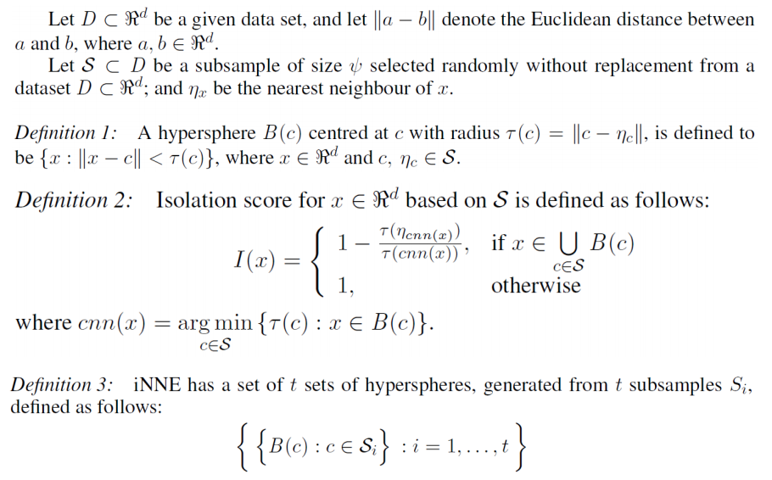
INNE definitions
https://federation.edu.au/__data/assets/pdf_file/0011/443666/ICDM2018-Tutorial-Final.pdf
[Bandaragoda et al, 2018]

Slide 32
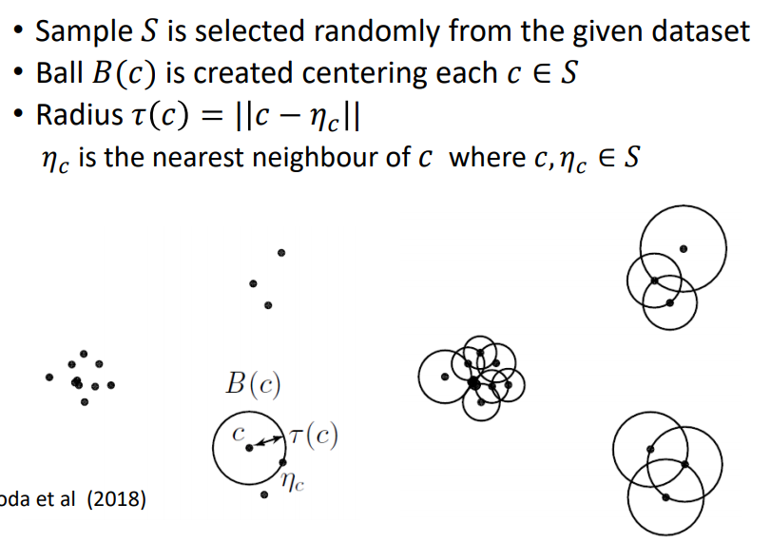
INNE idea
https://federation.edu.au/__data/assets/pdf_file/0011/443666/ICDM2018-Tutorial-Final.pdf
[Bandaragoda et al, 2018]

Slide 33
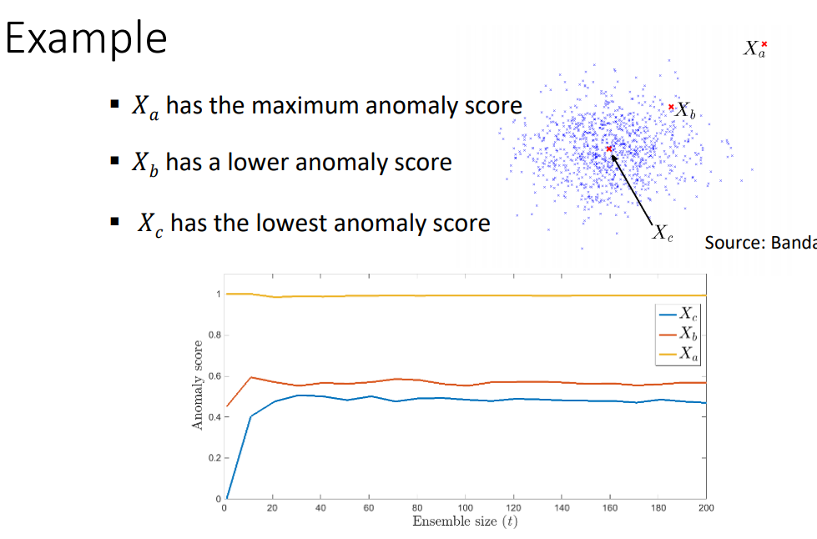
INNE idea
https://federation.edu.au/__data/assets/pdf_file/0011/443666/ICDM2018-Tutorial-Final.pdf
[Bandaragoda et al, 2018]

Slide 34
NN-based unsupervised anomaly detection

Slide 35
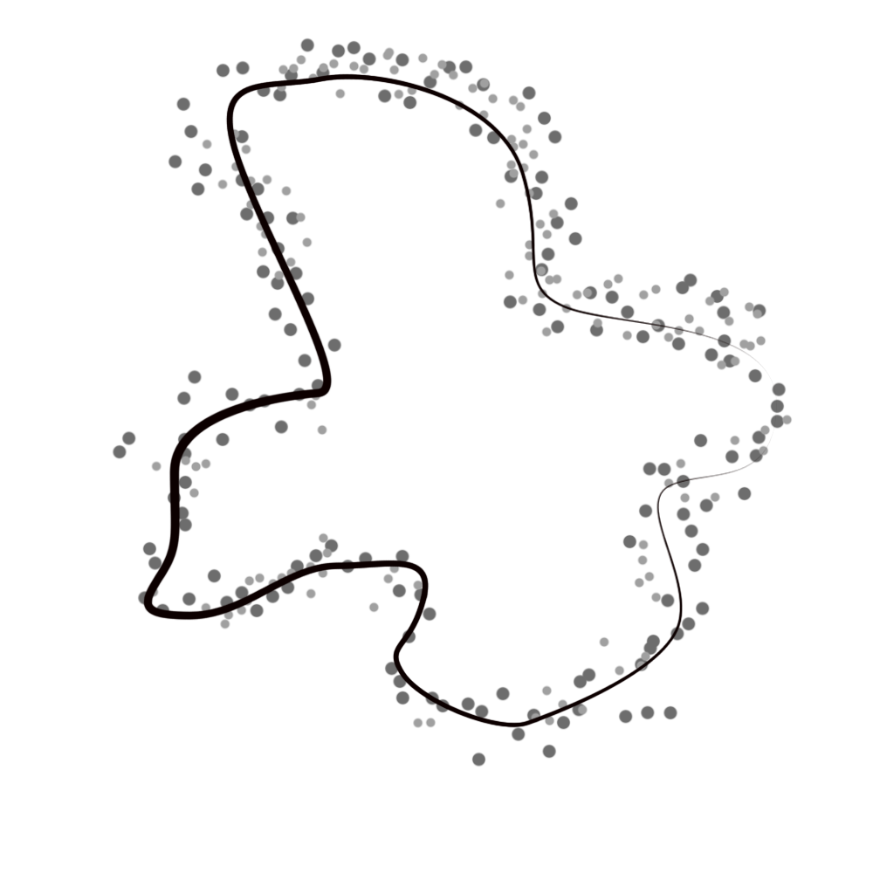
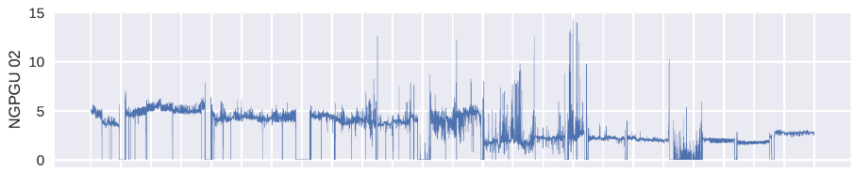
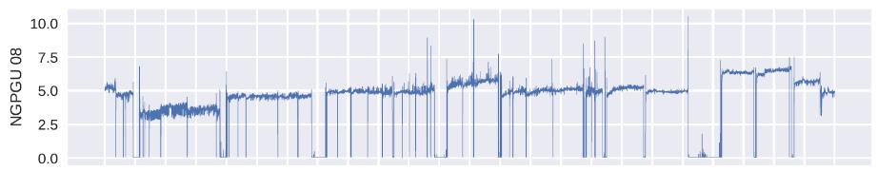
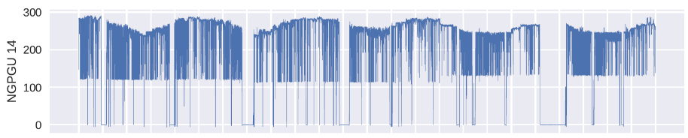
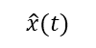
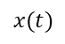
General embeddings-based approach
Embedding
Local history
Prediction
$$\hat{x}(t)$$
Measurement
$$x(t)$$
Anomaly score
Anomaly

Slide 36
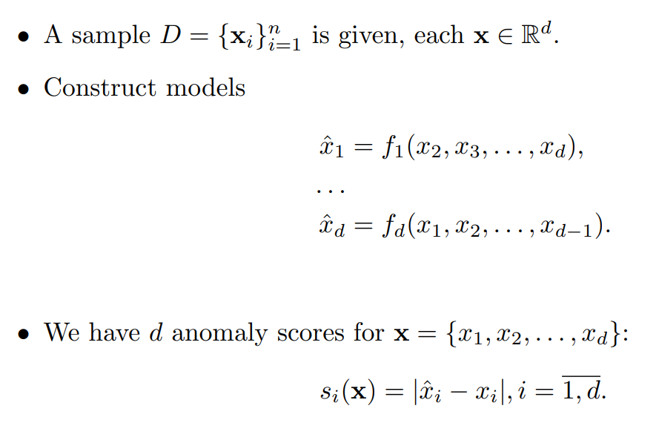
General approach-1 revisited

Slide 37
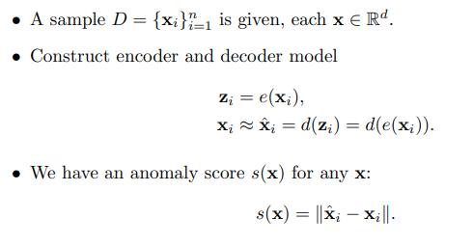
General approach-2
E.g. PCA, autoencoder

Slide 38
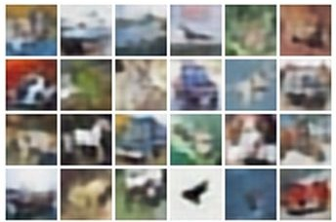
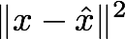
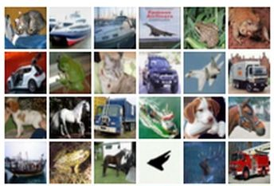
Autoencoder
Train such that features can be used to reconstruct original data
Reconstructed data
L2 Loss function:
Don’t need labels!
Reconstructed input data
Features
Encoder: 4-layer conv
Decoder: 4-layer upconv
Input data
Input data
Slides were adapted from lecture by Fei-Fei Li & Justin Johnson & Serena Yeung

Slide 39
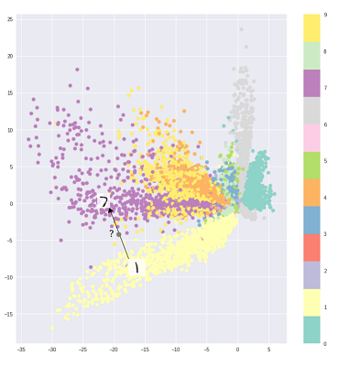
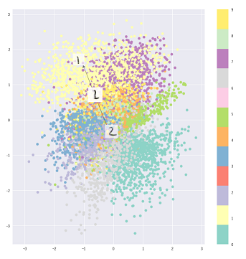
Taxonomy of autoencoders
Just autoencoder Sometimes we need just nonlinear PCA The latent space may not be continuous or allow easy interpolation.
Variational autoencoder If you want precise control over your latent representations and what you would like them to represent, then choose VAE. Sometimes, precise modeling can capture better representations
Adversarial autoencoder
AE
VAE
https://towardsdatascience.com/intuitively-understanding-variational-autoencoders-1bfe67eb5daf
https://arxiv.org/abs/1506.02216

Slide 40
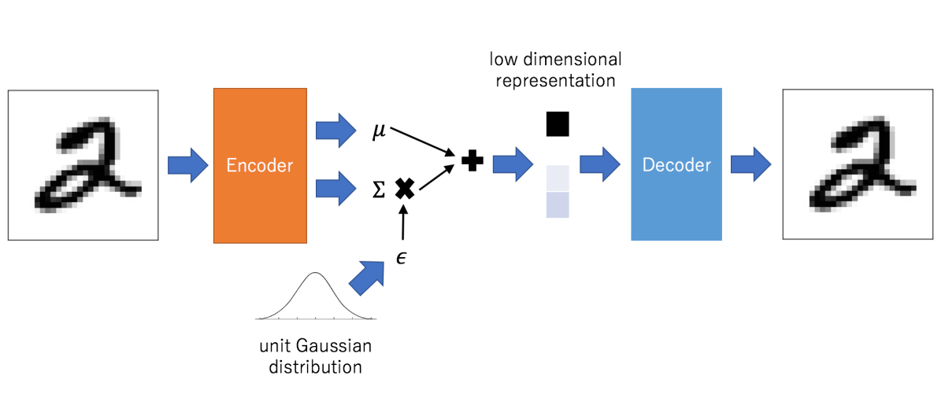
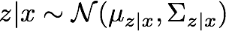
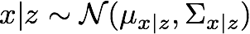
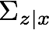
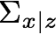
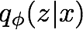
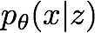
Variational autoencoder
Sample z from
Sample x|z from
Encoder network
Decoder network
(parameters ɸ)
(parameters θ)
https://arxiv.org/pdf/1606.05908.pdf

Slide 41
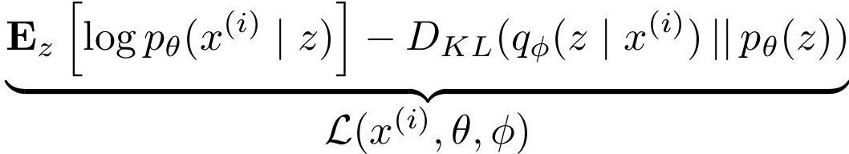
Variational autoencoder: formulas
We maximize the likelihood lower bound
Maximize likelihood of original input being reconstructed
Sample x|z from
Decoder network
Sample z from
Make approximate posterior distribution close to prior
Encoder network
Input Data
https://arxiv.org/pdf/1606.05908.pdf

Slide 42
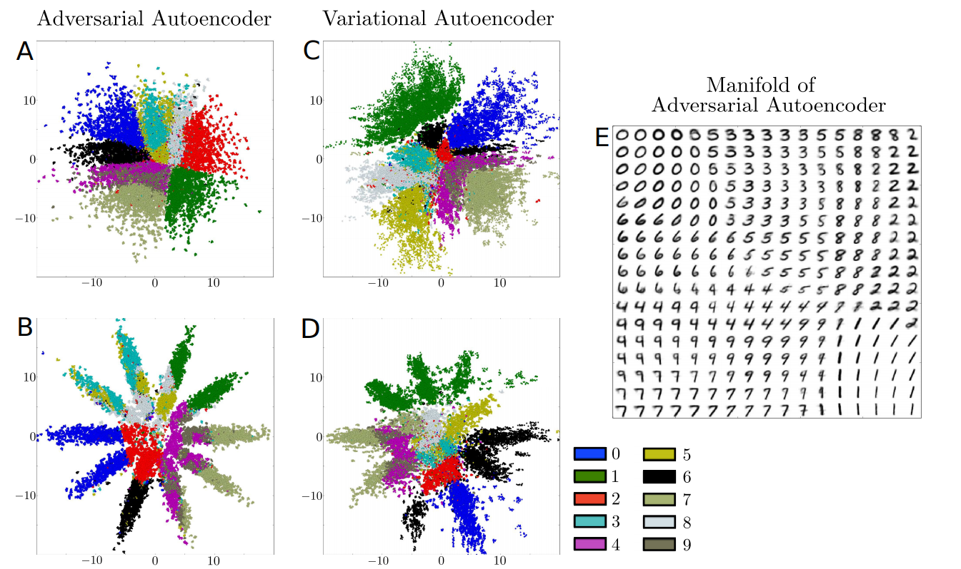
Adversarial autoencoder
2-D Gaussian
10-D Gaussian
https://arxiv.org/pdf/1511.05644.pdf

Slide 43
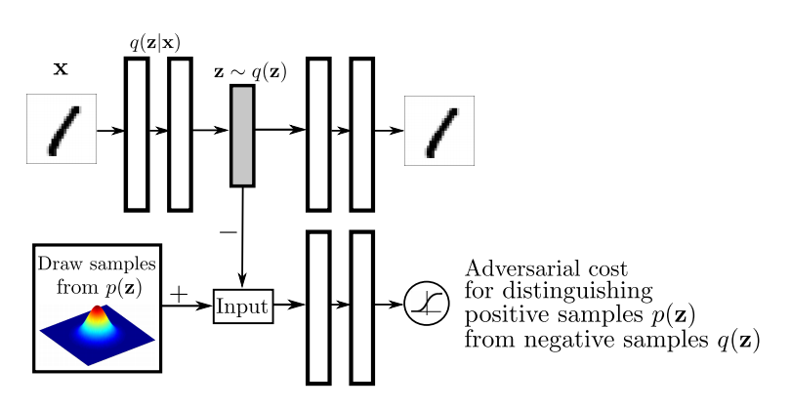
Adversarial autoencoder
Autencoder / Generator
Discriminator
https://arxiv.org/pdf/1511.05644.pdf

Slide 44
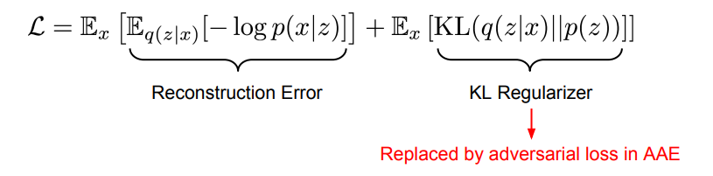
Adversarial autoencoder: formulas
https://arxiv.org/pdf/1511.05644.pdf

Slide 45
GANs
Generator network: try to fool the discriminator by generating real-looking images
Discriminator network: try to distinguish between real and fake images
Train jointly in minimax game
Discriminator outputs likelihood in (0,1) of real image
Minimax objective function:
Discriminator output for real data x
Discriminator output for generated fake data G(z)
Discriminator (θ_{d}) wants to maximize objective such that D(x) is close to 1 (real) and D(G(z)) is close to 0 (fake)
Generator (θ_{g}) wants to minimize objective such that D(G(z)) is close to 1 (discriminator is fooled into thinking generated G(z) is real)

Slide 46
More general approach to anomaly detection
Construct anomaly score a(x) using data
Signal about anomaly if anomaly score is greater than some threshold t*
*threshold selection is a separate problem, as we have only positive examples

Slide 47
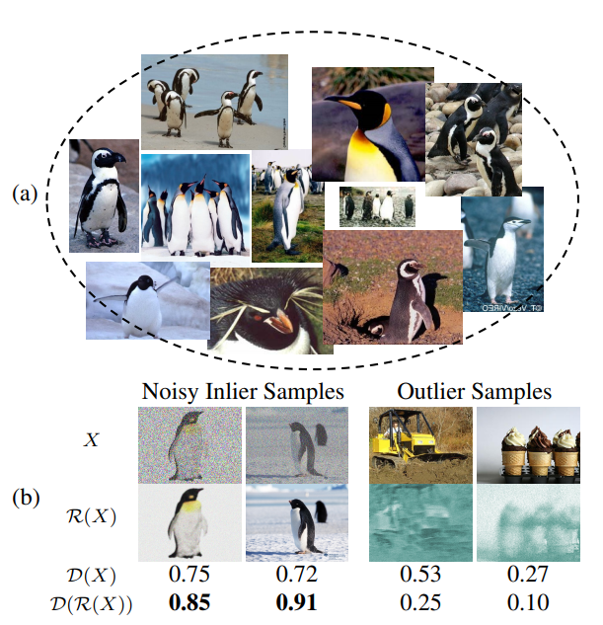
Adversarial autoencoders help
https://arxiv.org/abs/1802.09088
The model is trained using images of penguins
If we use noisy inliers and pass them to R NN, we get enhanced images as the output
If we use outlier sample instead, the output of R is distorted
M. Sabokrou et al. Adversarially Learned One-Class Classifier for Novelty Detection, CVPR, 2018

Slide 48
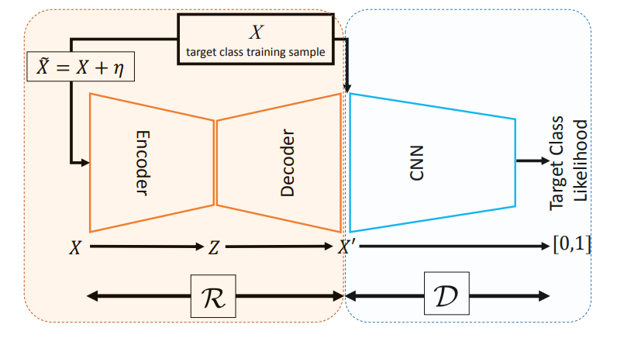
Overall architecture has “generator” and “discriminator”
https://arxiv.org/abs/1802.09088
Autoencoder generator Discriminator gives anomaly score

Slide 49
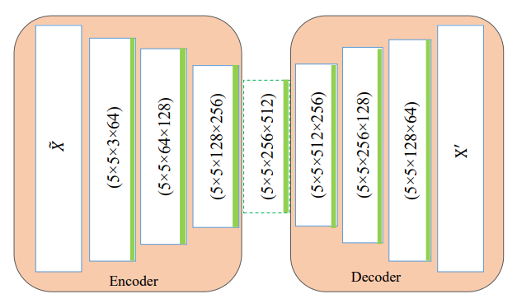
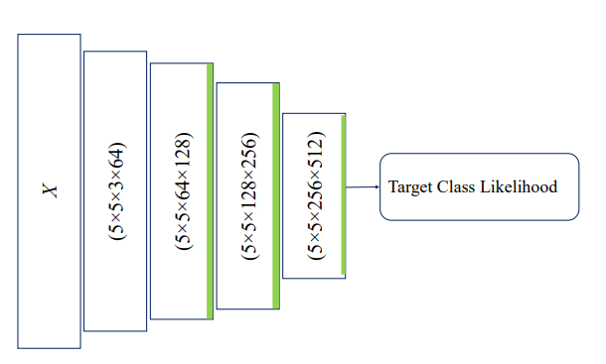
Internal architectures
https://arxiv.org/abs/1802.09088
Autoencoder generator Discriminator gives anomaly score

Slide 50
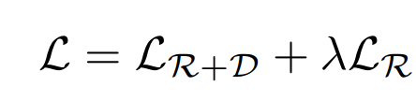
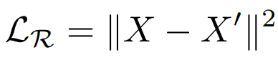
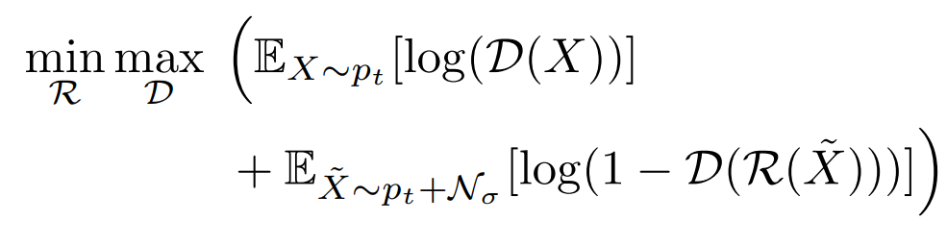
Loss function
https://arxiv.org/abs/1802.09088
Full loss function:
Loss function for difference between the initial object and reconstruction (can be log loss instead)
Loss function similar to VAE & GAN

Slide 51
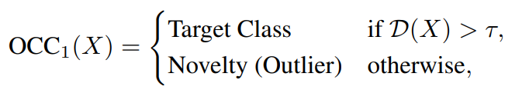
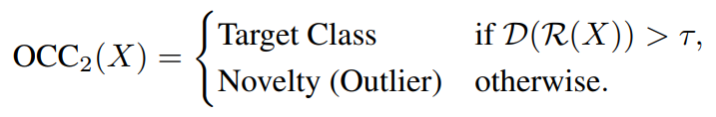
Usage of the model
https://arxiv.org/abs/1802.09088
Anomaly score with state-of-the-art performance:
Anomaly score that utilizes encoder-decoder

Slide 52


Model quality
https://arxiv.org/abs/1802.09088

Slide 53

Adversarial autoencoders help
https://papers.nips.cc/paper/7915-generative-probabilistic-novelty-detection-with-adversarial-autoencoders.pdf
Construct anomaly score a(x) using data
Signal about anomaly if anomaly score is greater than some threshold t

Slide 54
Factors to consider when choosing an anomaly Detector
Few parameters
• parameter-free the best
• easy to tune; not too sensitive to parameter setting
• Fast runtime: can scale up to large datasets and high dimensional datasets
• Low space complexity
• Known behaviours under different data properties
• Can deal with different types of anomalies
• Its ability to deal with high dimensional problems
• Understand the nature of anomalies and the best match algorithm
https://federation.edu.au/__data/assets/pdf_file/0011/443666/ICDM2018-Tutorial-Final.pdf

Slide 55
Take-home messages
Anomaly detection is a challenging problem
Often problem-specific knowledge helps
Common approaches are Autoencoder-based and Isolation forest
There are some time-series specific approaches: the problem is similar to the change detection problem

